Slide 1

Logistic Regression
By
KIET Group of Institutions

Slide 2
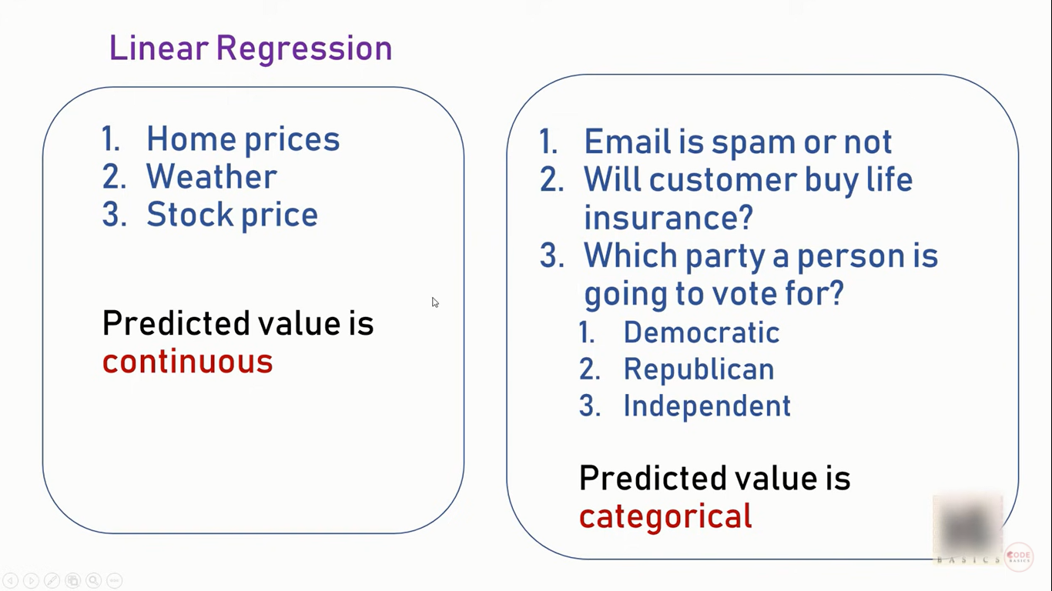
Linear Regression
Classification

Slide 3
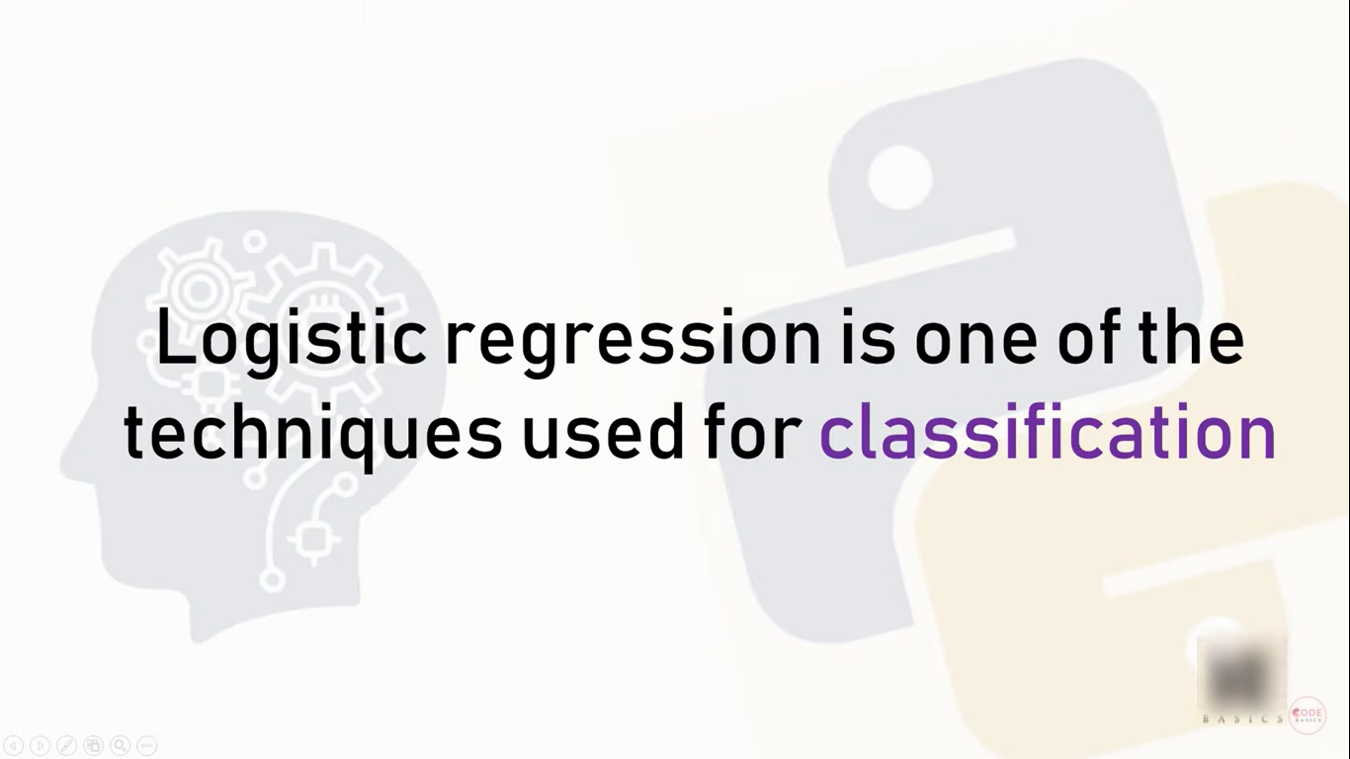

Slide 4
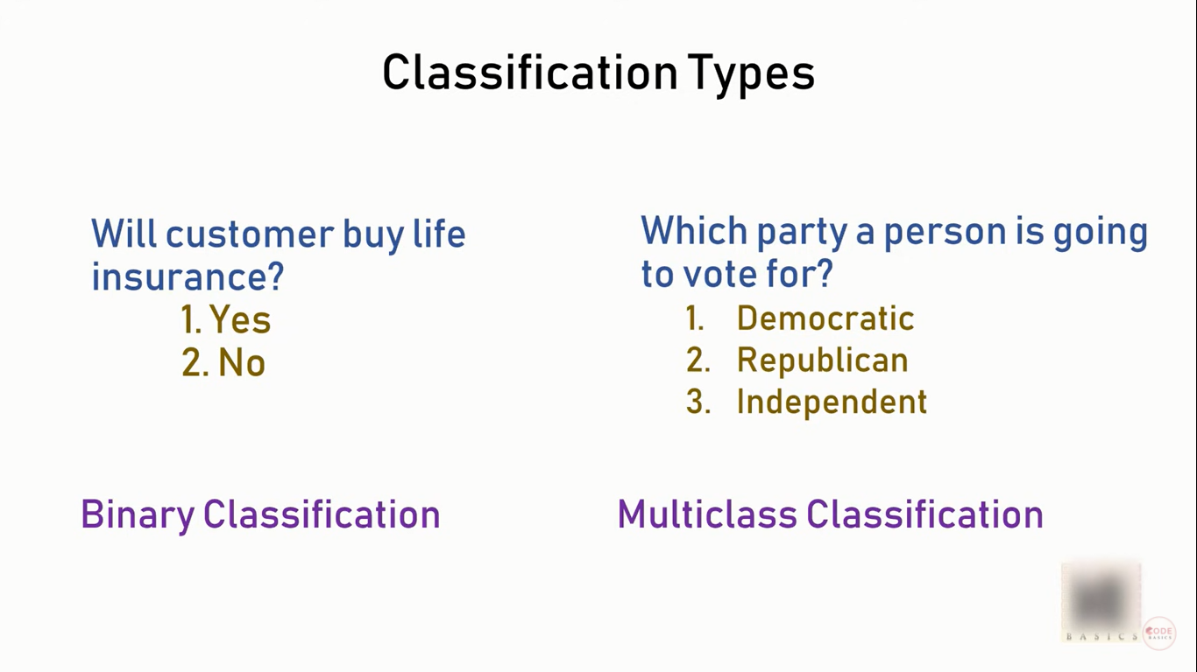

Slide 5
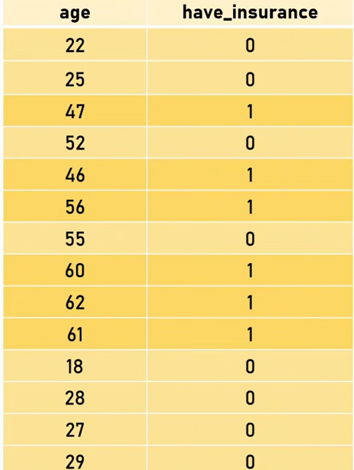
Let’s say we want to predict how likely a potential customer is to buy insurance product

Slide 6
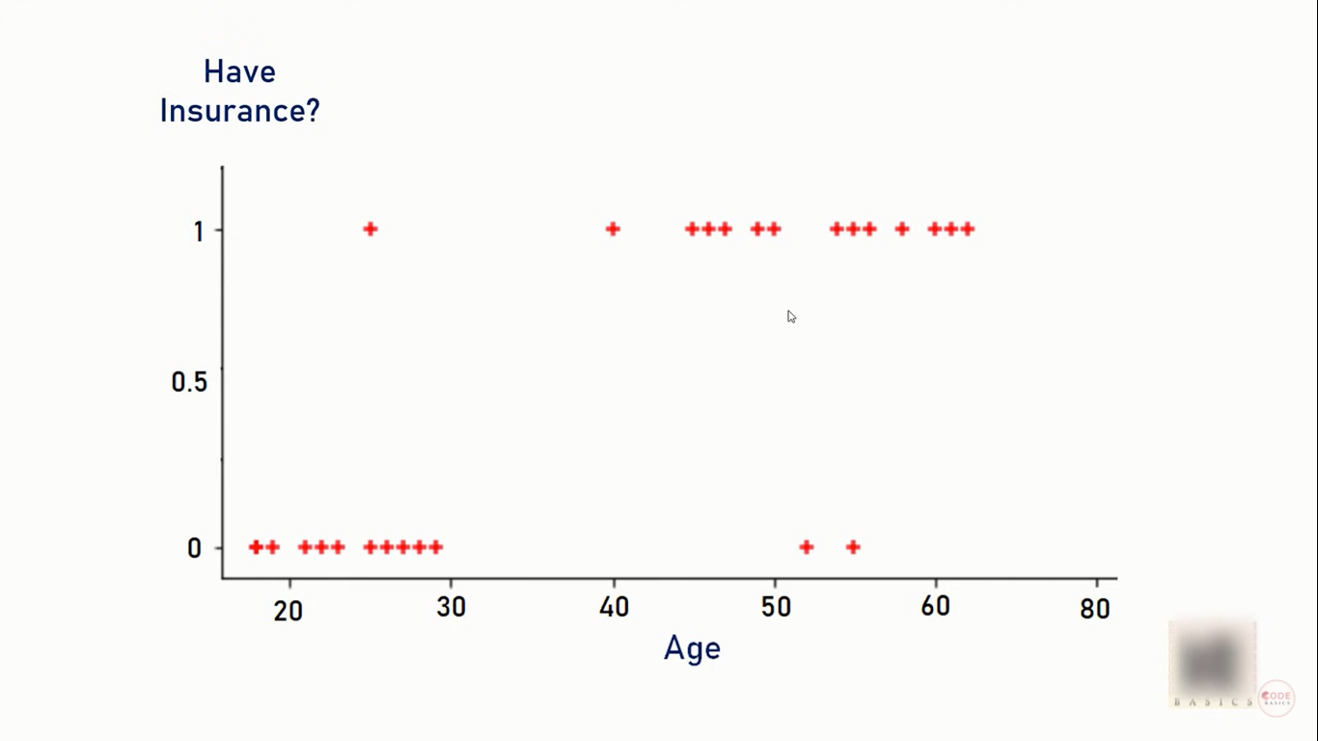
This is how its scatter plot looks like

Slide 7
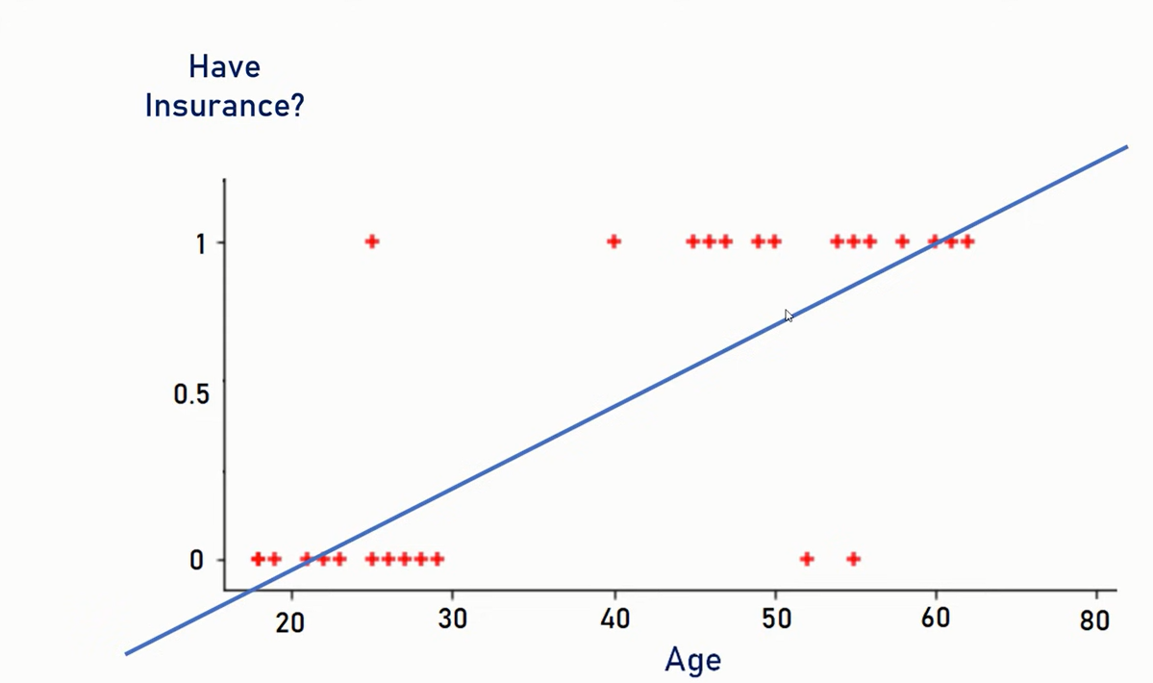
After applying Linear Regression

Slide 8

We can predict the linear regression line and say that if the value is more than 0.5 then the customer is likely to buy insurance
Notes:
Anything on right hand side is yes and anything on left hand side is no

Slide 9
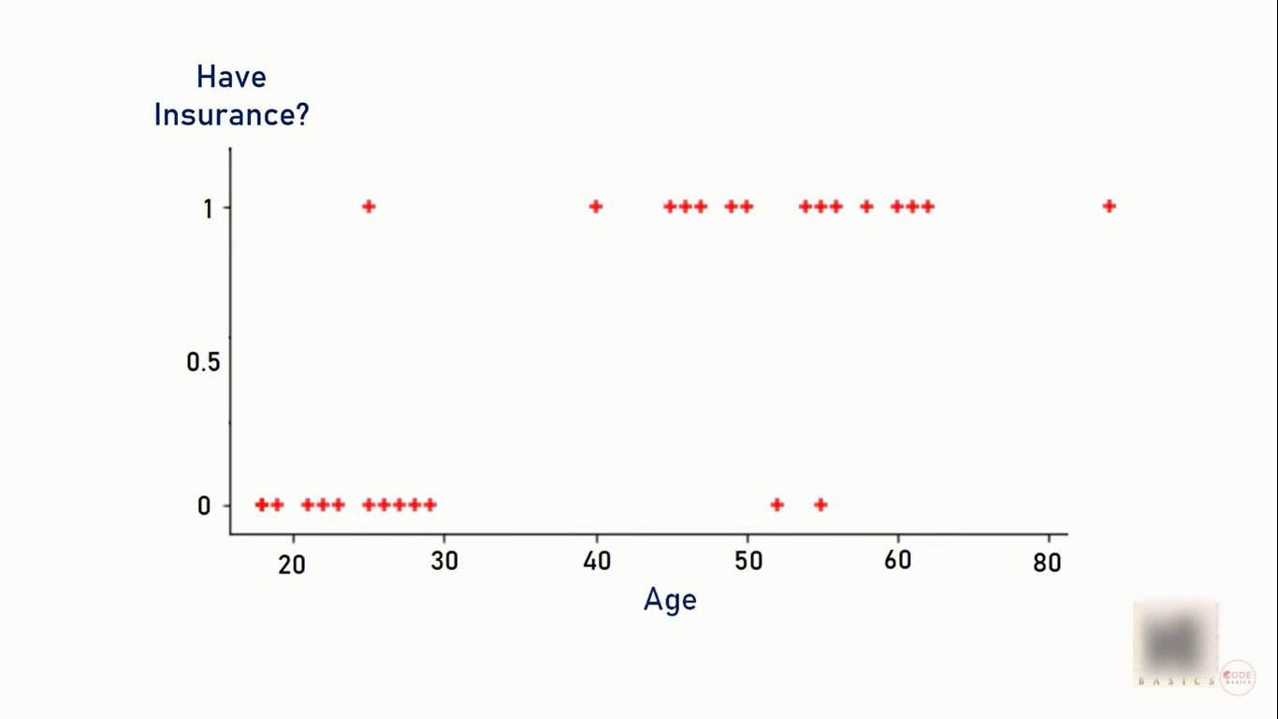
Let’s say a customer is more than 80 years is there then the scatter plot looks like this
Notes:
Anything on right hand side is yes and anything on left hand side is no

Slide 10
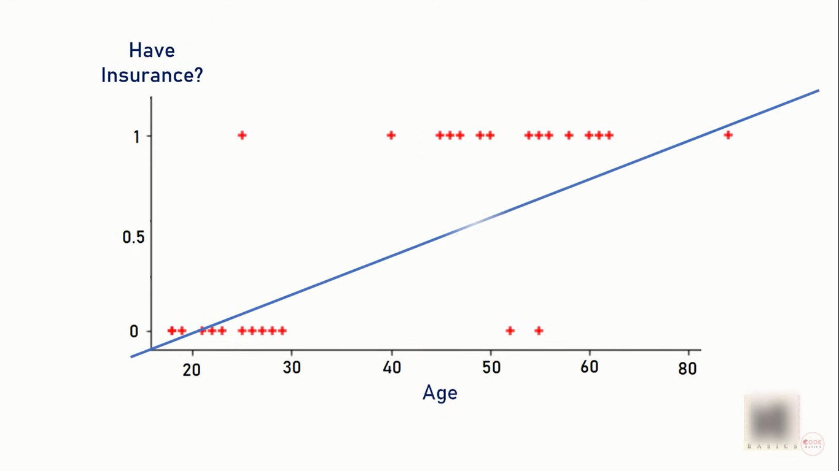
Now its linear regression might look like this
Notes:
Anything on right hand side is yes and anything on left hand side is no

Slide 11
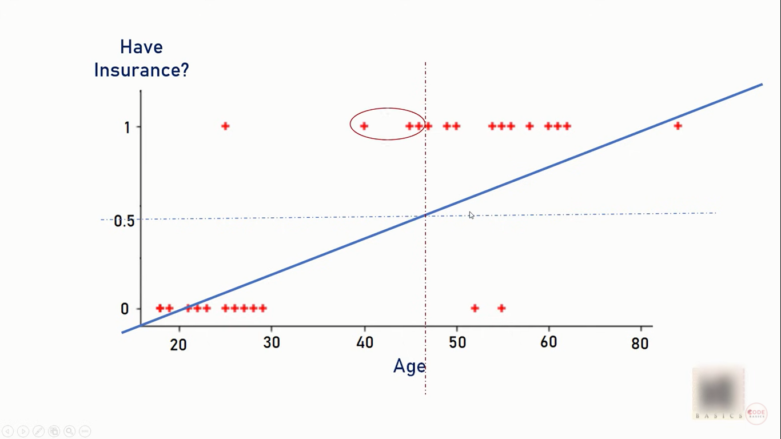
Here the problem arises

Slide 12
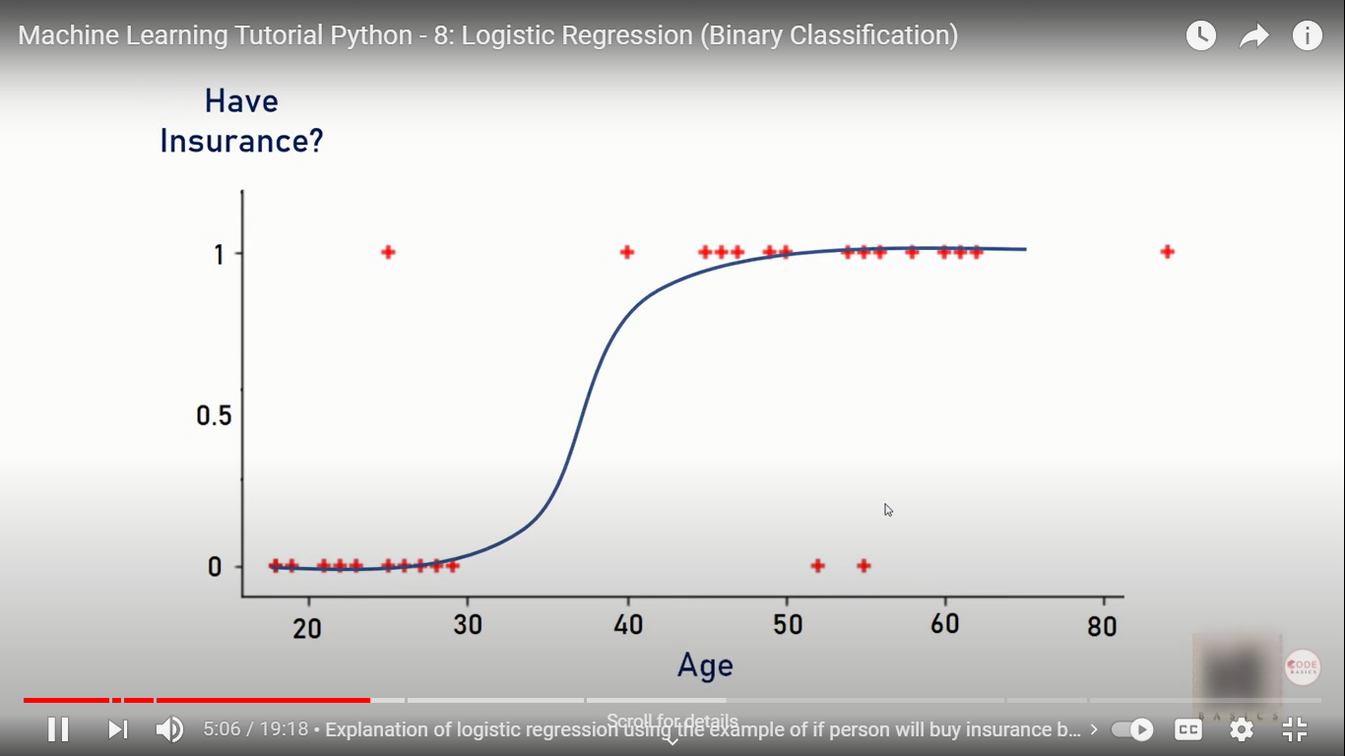
Here the Imagine if you draw a line like this

Slide 13
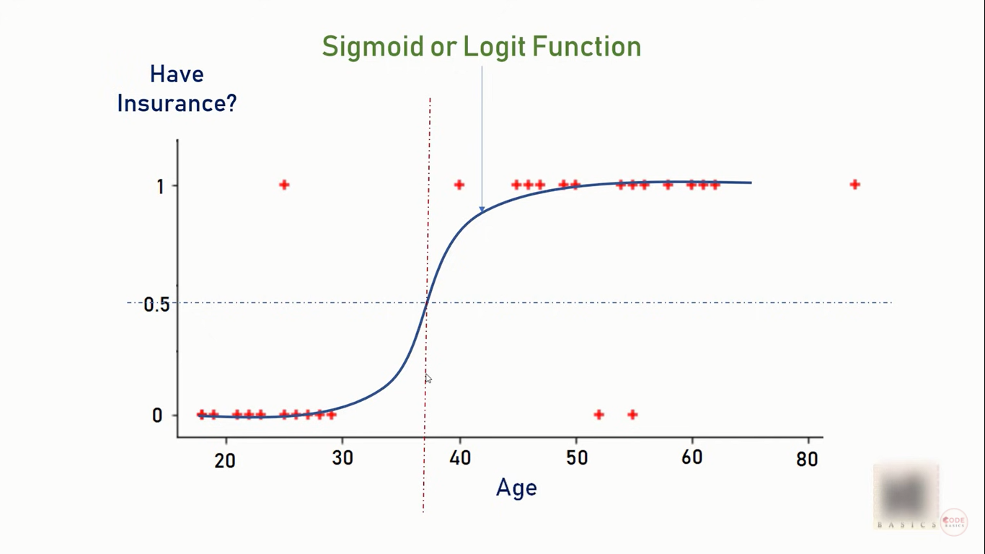
Here we can clearly see that this works much better than linear regression

Slide 14
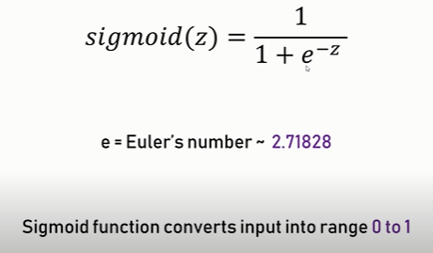

Slide 15
Various applications of Logistic Regression
Fraud detection: Detection of credit card frauds or banking fraud is the objective of this use case.
Email spam: Classifying the email as spam or ham and putting it in either Inbox or Spam folder is the objective of this use case.
Sentiment Analysis: Analyzing the sentiment using the review or tweets is the objective of this use case. Most of the brands and companies use this to increase customer experience.

Slide 16
Various applications of Logistic Regression
Image segmentation, recognition and classification: The objective of all these use cases is to identify the object in the image and classify it.
Object detection: This use case is to detect objects and classify them not in the image but the video.
Handwriting recognition: Recognizing the letters written is the objective of this use case.
Disease (diabetes, cancer etc.) prediction: Predicting whether the patient has disease or not is the objective of this use case.

Slide 17
Disadvantages of Logistic Regression
If the number of observations is lesser than the number of features, Logistic Regression should not be used, otherwise, it may lead to overfitting.
The major limitation of Logistic Regression is the assumption of linearity between the dependent variable and the independent variables.
It can only be used to predict discrete functions. Hence, the dependent variable of Logistic Regression is bound to the discrete number set.

Slide 18
References
https://www.youtube.com/watch?v=zM4VZR0px8E
https://www.youtube.com/watch?v=DooxDIRAkPA
https://www.geeksforgeeks.org/advantages-and-disadvantages-of-logistic-regression/

Slide 19
THANK YOU

